Slide 1

User Manual
Sensor Name :
Body pH Sensor
Presented by :
Aditi Bhale - 32204

Slide 2
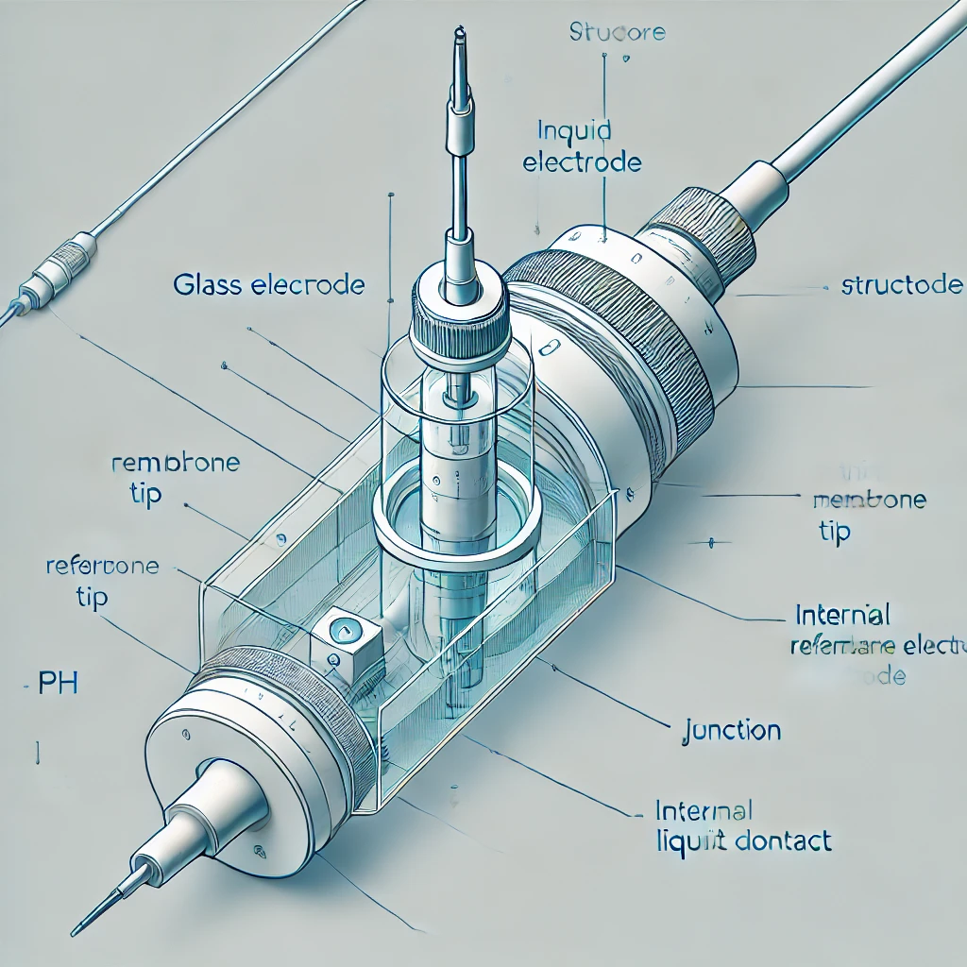
Body pH Sensor
Model No. : US100
Uses of Urea Sensor :
Blood pH Monitoring : used in medical devices to monitor blood pH levels in patients, helping to detect conditions like acidosis or alkalosis, which can indicate respiratory or metabolic disorders.
Urine pH Testing: used to measure the acidity or alkalinity of urine, which can help diagnose kidney stones, urinary tract infections, or other metabolic conditions.
Wound Healing: monitor the pH levels of wounds, helping healthcare professionals assess healing progress and detect potential infections.
Digestive Health: used in the gastrointestinal tract, particularly in diagnosing acid reflux (GERD) by measuring the acidity levels in the esophagus over time..

Slide 3
Features of Body pH Sensor
Real-time monitoring of pH levels in bodily fluids
High accuracy for detecting small variations in acidity and alkalinity.
Compatibility with biosensor platforms for medical and industrial use.
Portable design for field or point-of-care testing.
Cost :The cost of body pH sensors typically ranges from $5 for basic strips to over $1,000 for advanced wearable models.
Availability :
Online retailers: from various e-commerce platforms
Can be purchased from biomedical and industrial sensor manufacturers or online
Medical supply stores have pH sensors for clinical use

Slide 4
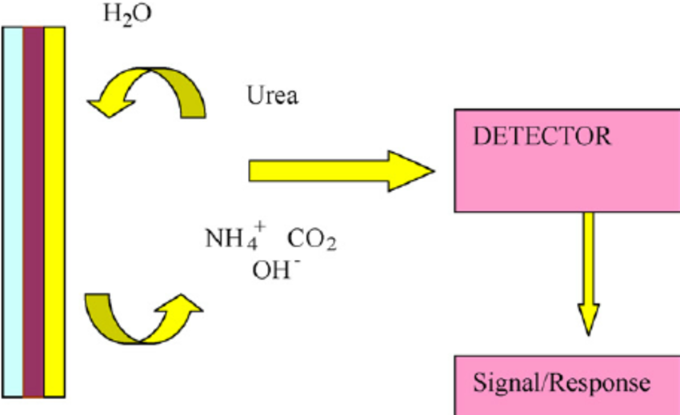
Working of Body pH Sensor
The body pH sensor operates by using a glass electrode that interacts with hydrogen ions in the body fluid. This interaction generates a small electrical potential that is proportional to the pH level.The sensor's transducer converts this potential into an electrical signal, which is then processed by a microcontroller to determine the pH value.The processed data is transmitted to a display device or smartphone app in real-time, allowing users to monitor their body’s acidity or alkalinity.
Sample Introduction: The bodily fluid sample (e.g., blood, saliva, or urine) is introduced to the pH sensor.
Electrode Interaction: The sample interacts with a specialized glass electrode that is sensitive to hydrogen ion concentration.
Ion exchange: The glass electrode allows hydrogen ions to diffuse through its surface, generating a potential difference based on the pH level of the sample.
Signal Detection: The generated potential difference is detected and measured as an electrical signal by the sensor's transducer.
Signal Transduction: This electrical signal is converted into a digital format for processing.
Data Processing:The signal is processed by a microcontroller to determine the pH level of the sample.

Slide 5
Description of Urea Sensor’s Elements :
Sensing Layer :Composed of a glass electrode that interacts with hydrogen ions in the bodily fluid to produce a measurable potential difference.
Transducer :Converts the potential difference (pH change) into an electrical signal for further analysis.
ADC (Analog to Digital Converter) : Converts the electrical signal into digital format for processing.
Microcontroller : Analyzes the signal and determines the concentration of urea in the sample.
Power Source: Can be powered by a battery, rechargeable lithium-ion, or USB power, depending on the design of the sensor.
Transmitter :Communicates the processed pH data wirelessly via Bluetooth or Wi-Fi to external devices or apps for real-time monitoring and logging.

Slide 6
Description of the User Interface :
Wearable or Handheld Sensor: A compact device designed for easy sample collection and measurement of pH levels in bodily fluids.
Receiver Device: A smartphone, computer, or dedicated monitor that displays real-time pH readings for user convenience.
Graphical Representations: Visual graphs showing pH trends over time for in-depth analysis and tracking of changes.
Alerts and Alarms: Notifications for abnormal pH levels, prompting users to take necessary actions.
Data Storage and Analysis Features: Capabilities for long-term monitoring, storing historical data, and generating reports for health assessments.

Slide 7
THANK YOU !!!

